Slide 1
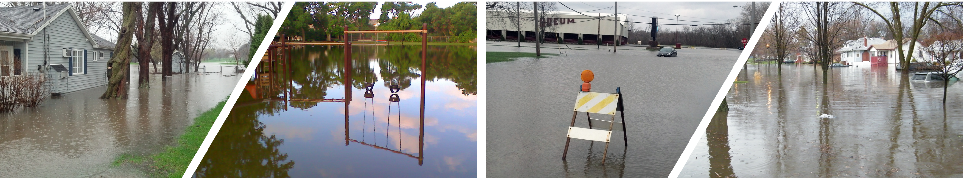
Village of Villa Park
October 24, 2016
Washington Street Combined Sewer Separation Project

Slide 2
Project Background
Washington Street Combined Sewer Separation originally identified in the Comprehensive Flood Plan
Area currently consists of combined sewer intermixed with separate storm sewer
Combined sewer separation must be completed prior to implementing flood improvement projects
Proposed storm sewer will service areas that currently drain to combined sewer
Allows for future elimination of 48-inch Combined Sewer Overflow (CSO) to Salt Creek and construction of previously identified flood reduction projects

Slide 3
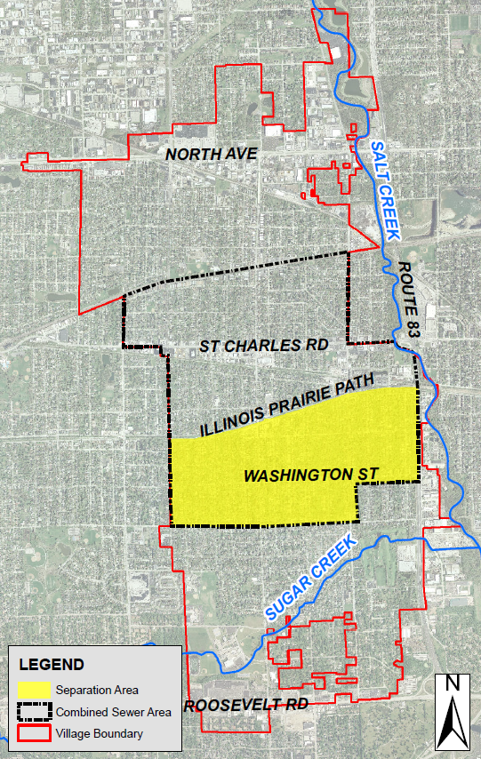
Washington Street Sewer Combined Separation Area
Village Area = 3000 acres
Combined Sewer Area = 1200 acres
Goal is 100% sewer separation in this area
Combined sewers intermixed with separate storm sewers
Combined Sewer in area drains to Salt Creek
Existing separate storm sewers in area drain to both Sugar Creek & Salt Creek

Slide 4
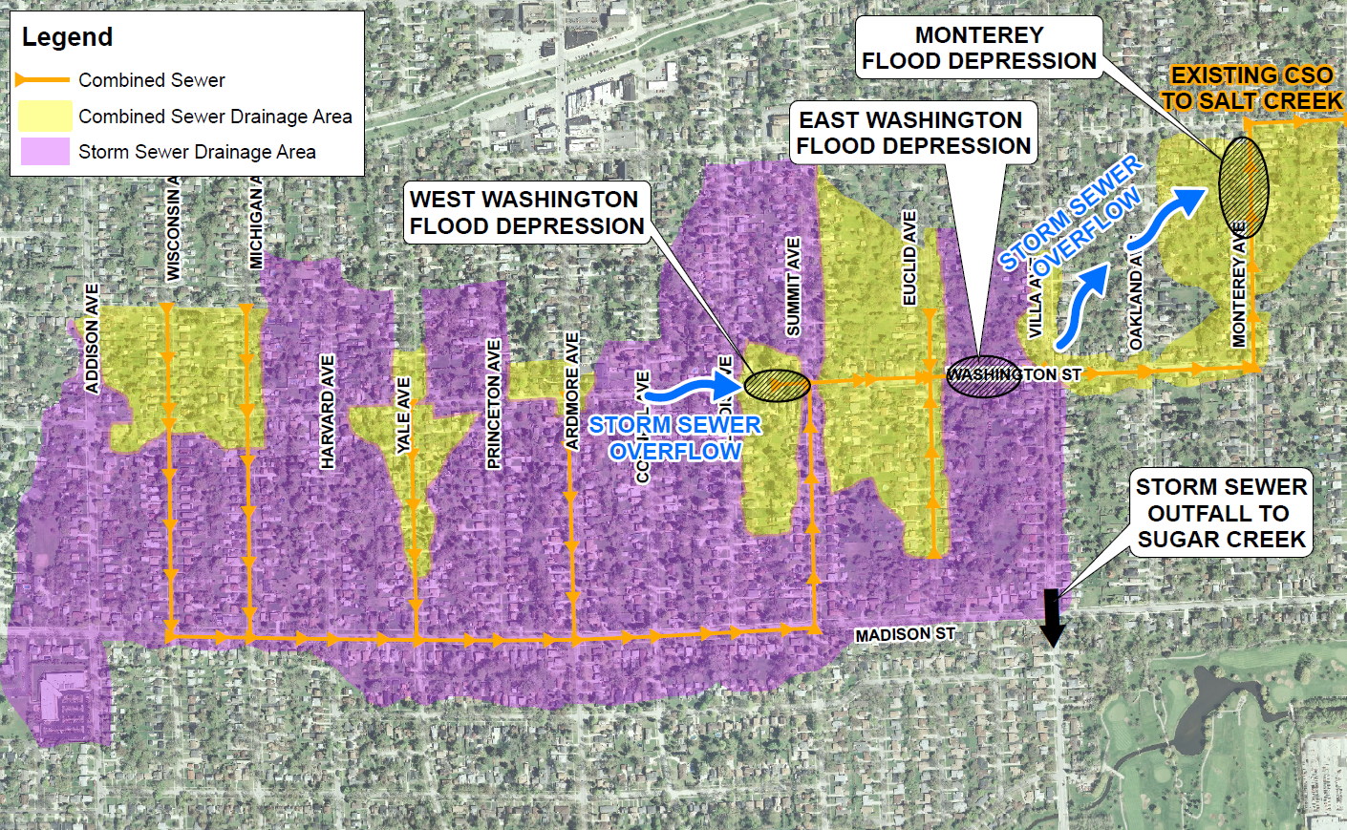
Washington Street Existing Combined Sewer Drainage
The combined sewer system drains 87 acres of tributary area and storm sewer surcharge contributes additional overland flow to the flood depressions

Slide 5
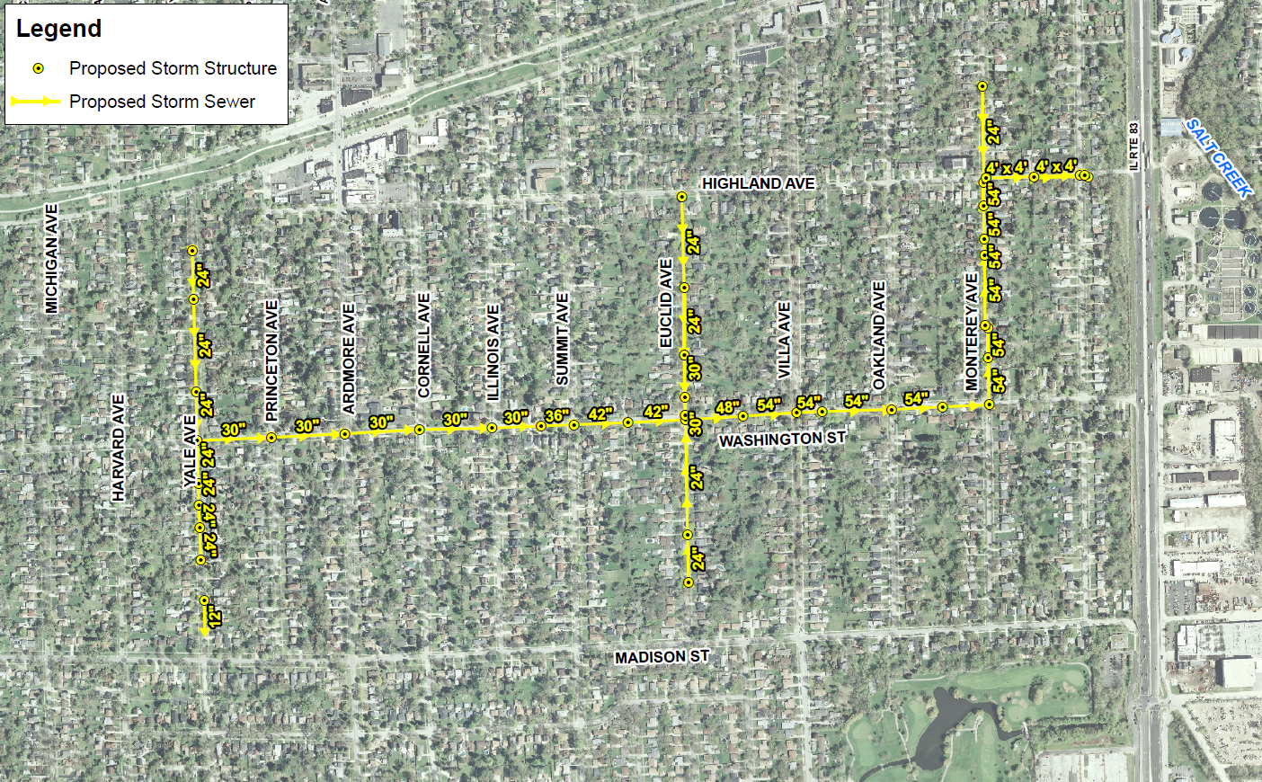
Washington Street Combined Sewer Separation Install New Storm Sewer
Project Cost Estimate = $8.7 Million

Slide 6
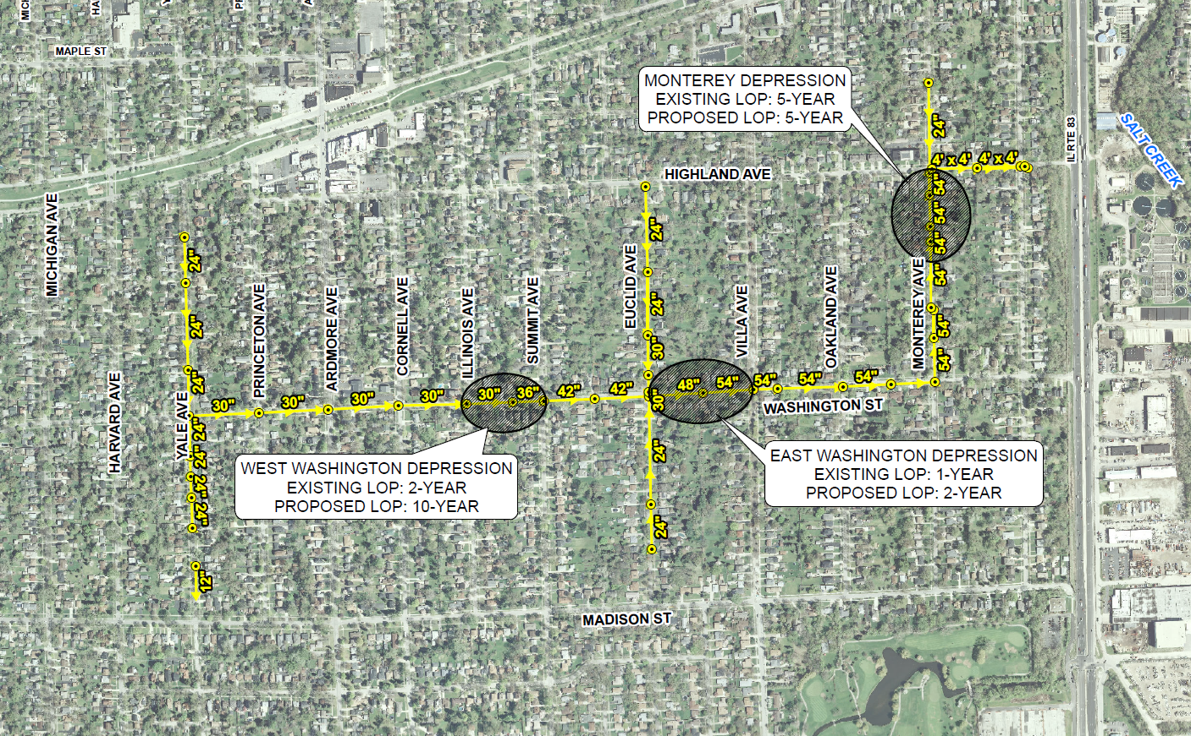
Washington Street Combined Sewer Separation Install New Storm Sewer
Provides immediate flood reduction benefit to problem areas for higher frequency storm events

Slide 7
Washington Street Combined Sewer Separation
Proposed storm sewer ties into existing 48-inch combined sewer outlet to Salt Creek - no new sewer construction under Route 83 is required
Project will incorporate green infrastructure components from Conservation Design Forum Plan:
Grant Street permeable pavers
Bioretention basin
Rain gardens and bioswales
Green infrastructure components provide significant stormwater quality benefits and flood reduction for events up to the 10-year storm
DuPage County will contribute up to $1 million in funding through a CDBG-DR grant for the green infrastructure improvements

Slide 8
Project Benefits Summary
Project Cost Estimate = $8.7 Million
Reduces potential for sewer backup for approximately 400 homes currently serviced by combined sewer
Separates 87 acres of combined sewer tributary area
Allows for future elimination of CSO
Allows for construction of above ground flood storage areas

Slide 9
Project Benefits Summary
Washington Street Combined Sewer Separation Project in combination with other completed/ongoing projects will achieve 100% sewer separation south of the Prairie Path
Combined sewer separation projects south of Prairie Path:
Project | Status | Drainage Area Converted from Combined to Storm (acres)
Washington Street Sewer Separation | Design Phase | 86.9
Park Boulevard Reconstruction | Complete | 15.3
Michigan Avenue Sewer Separation | Tentative Bid – Nov. 2016 | 8.3
Astor Myrtle Sewer Separation | Design Phase | 12.1
Wisconsin Avenue Sewer Separation | Concept Level | 12.4
Total Separation Area |  | 135

Slide 10
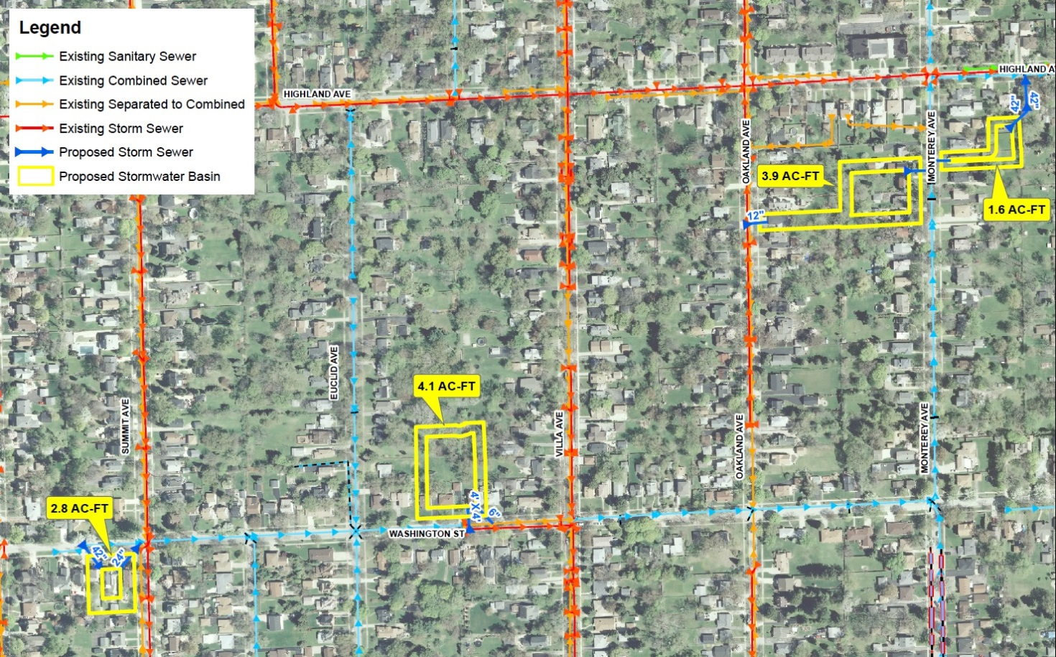
Future Flood Improvement Projects 100-Year Level of Protection
Create 12.4 ac-ft of gravity-drained flood storage on existing private & Village owned lots
Washington sewer separation (previously discussed) required
Removes 15 homes from 100-year inundation area
3” of ponding on Monterey Ave for the 100-year event
Conceptual Project Cost = $8.0 million*
*does not include land acquisition

