Slide 1

Salt Creek Forum Meeting
May 18, 2015

Slide 2
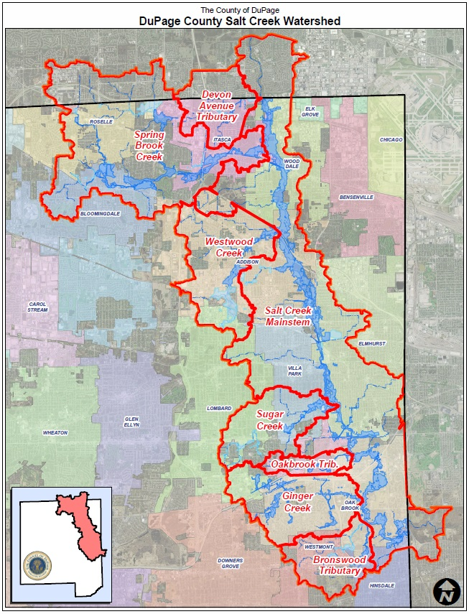
Lower Salt Creek Watershed

Slide 3
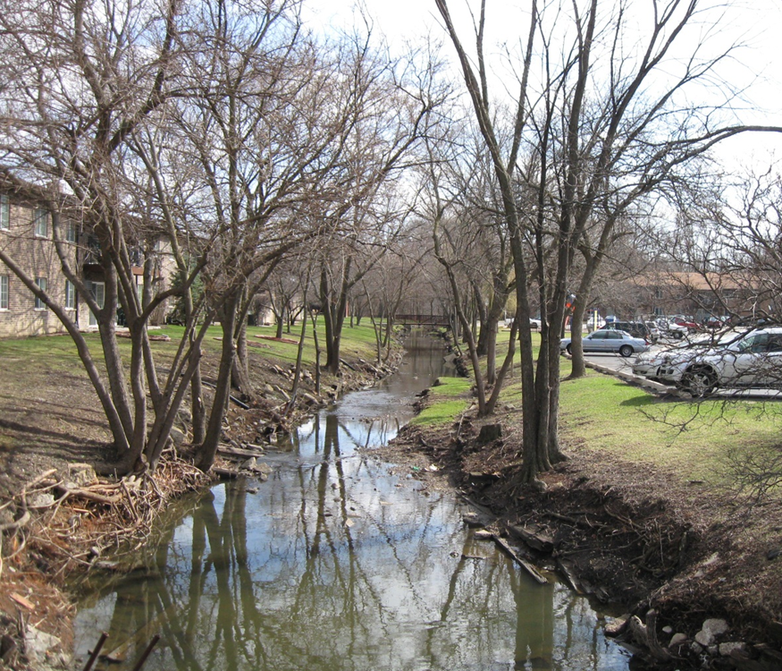
Watershed Planning Process
Hydrologic Model Development
Hydraulic Model Development
Identify Flood Prone Areas
Develop Flood Control Alternatives
Economic Model Development
Develop Cost Estimates for Project Alternatives

Slide 4
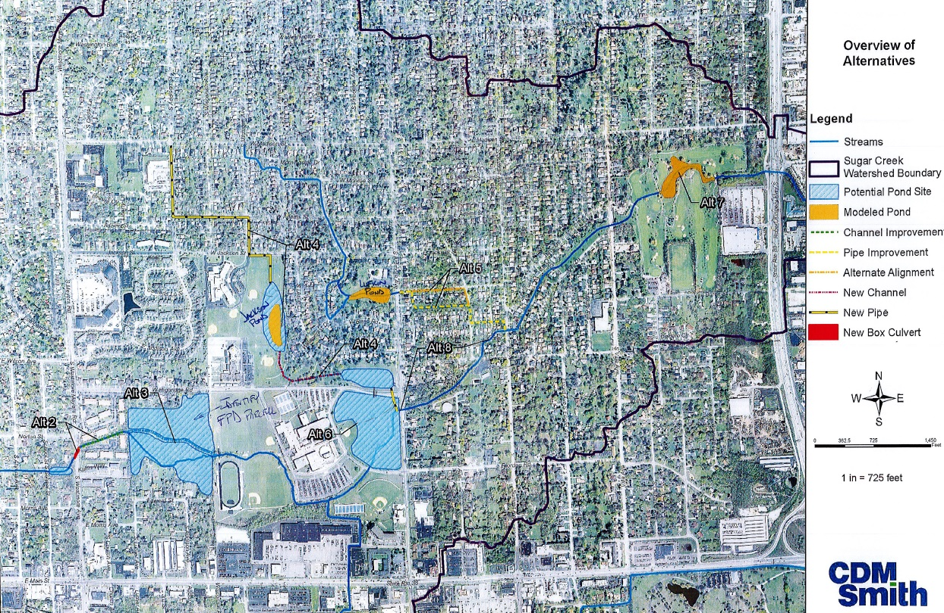
Sugar Creek Proposed Projects

